Slide 1


Depth-first search (DFS) Algorithm
Group 10​
MEGHLA SARKAR​
UMAKANTH SAI BALGURI​
SRI VENKATA VENU GOPAL GUDDATI​
ISM 6225 - Distributed Information Systems

Slide 2

Background and Motivation
What is an algorithm?
Correct problem-solving approach
Depth-first search (DFS)
Usage of DFS

Slide 3
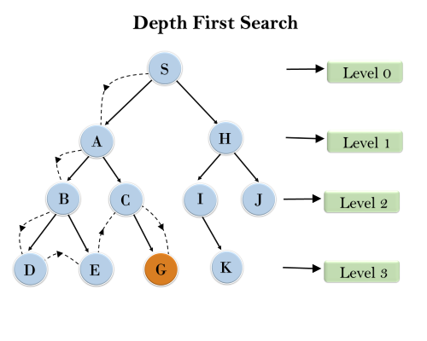
DFS- How it works ?
Depth-first paths from S to all vertices
to A: {S, A}
to B: {S, A, B}
to D: {S, A, B, D}
to E: {S, A, B, D, E}
to C: {S, A, B, D, E, C}
to G: {S, A, B, D, E, C, G}

Slide 4
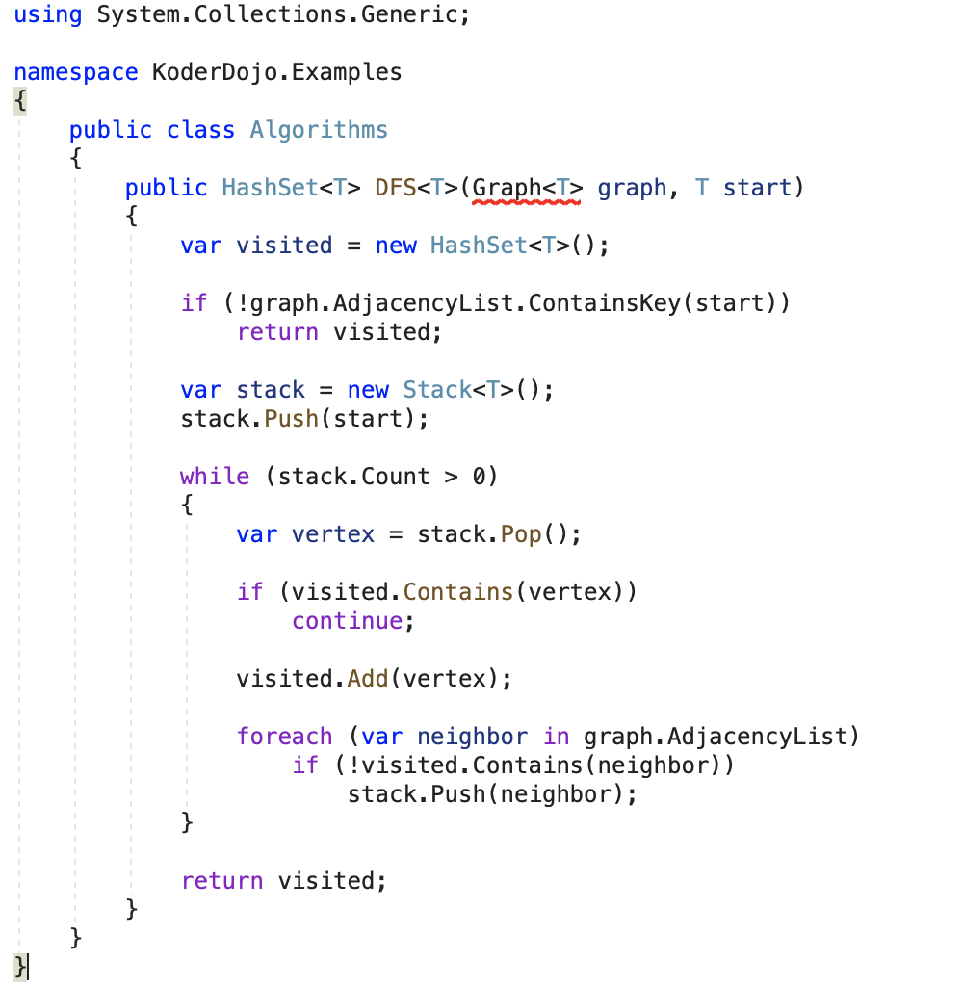
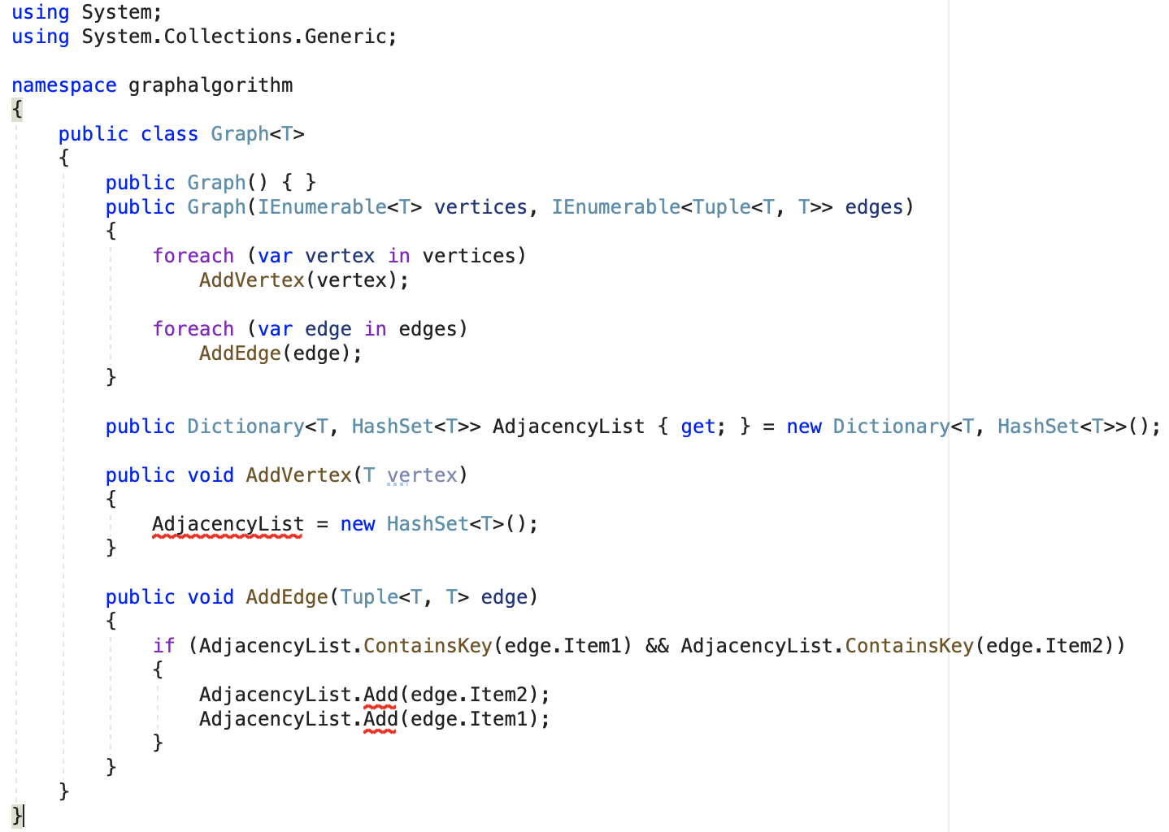
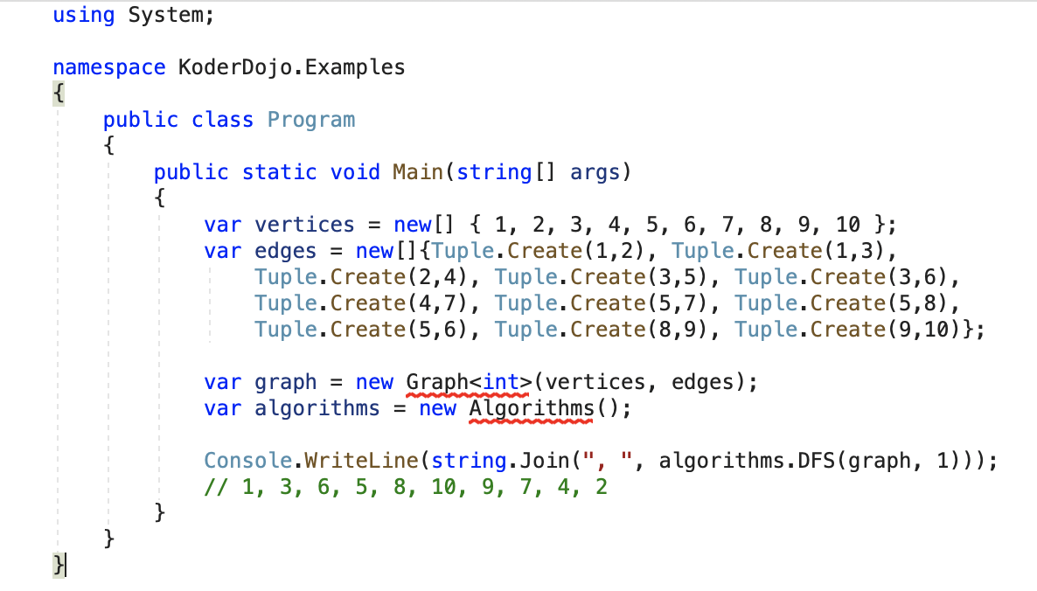
Depth-First search algorithm in C#

Slide 5
DFS Performance
Completeness: DFS search algorithm is complete
Time Complexity: O(n^{m}). Where, m= maximum depth of any node
Space Complexity: O(bm)
Optimal: Non-optimal

Slide 6
Advantages and Disadvantages
Advantages
DFS requires very less memory as it only needs to store a stack of the nodes on the path from root node to the current node.
It takes less time to reach to the goal node than BFS algorithm (if it traverses in the right path)
Disadvantages
There is the possibility that many states keep re-occurring, and there is no guarantee of finding the solution.
DFS algorithm goes for deep down searching and sometime it may go to the infinite loop.

Slide 7
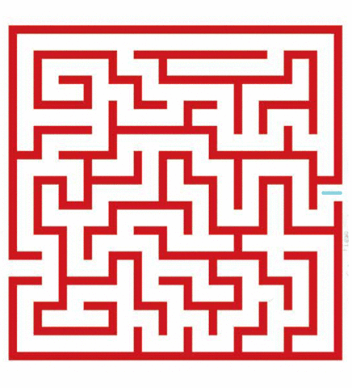
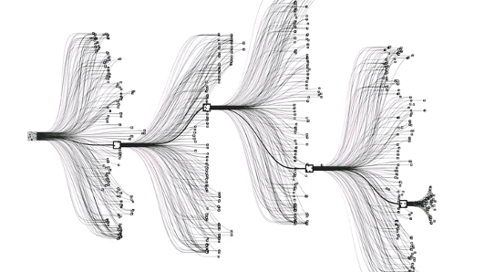
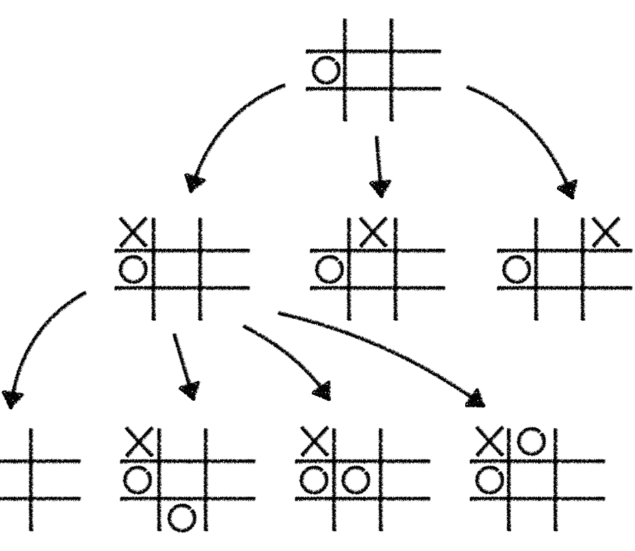
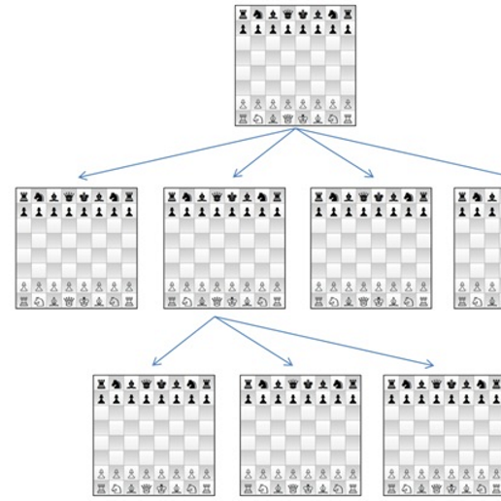
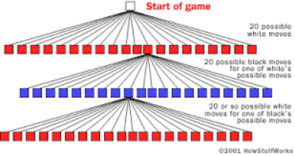
Real World Examples
Depth-first searches are often used in simulations of games. Ex: Chess
Topological sorting
To solve puzzle(sudoku/maze) which has one solution.
Artificial Intelligence(Alpha Go).

Slide 8
References
Needham, M., & Hodler, A. (n.d.). Graph Algorithms. From https://www.oreilly.com/library/view/graph-algorithms/9781492047674/ch04.html
Vaish, E. (n.d). Depth First Search or DFS for a Graph. From https://www.geeksforgeeks.org/depth-first-search-or-dfs-for-a-graph/
Uninformed Search Algorithms - Javatpoint. From: https://www.javatpoint.com/ai-uninformed-search-algorithms.
Valentin Bryukhanov. Labyrinth Algorithms. From: http://bryukh.com/labyrinth-algorithms
Jigyun.J, & Kakade, P. (2020, January 03). Applications of Depth First Search. From https://www.geeksforgeeks.org/applications-of-depth-first-search/
Depth First Search Tutorials & Notes: Algorithms. From https://www.hackerearth.com/practice/algorithms/graphs/depth-first-search/tutorial/
Gupta, D. BFS vs DFS for Binary Tree. Retrieved July 20, 2016, from https://www.geeksforgeeks.org/bfs-vs-dfs-binary-tree/
Depth-First Search (DFS). (n.d.). Retrieved February 01, 2021, from https://brilliant.org/wiki/depth-first-search-dfs/

